Slide 1
Acuity Knowledge Partners
Conference of the Parties of the UNFCCC – COP27
November 2022

Slide 2
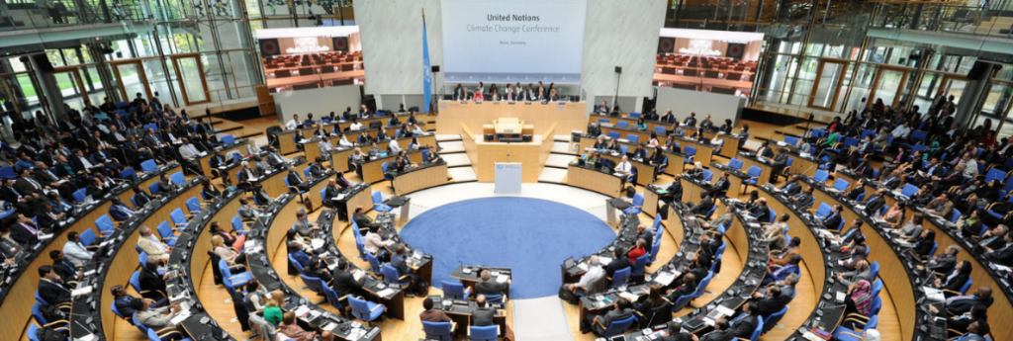
Introduction to United Nations Climate Change Conference
01

Slide 3












An Overview of UNFCCC
1995
Berlin
          The United Nations Framework Convention on Climate Change is the umbrella organization for yearly conferences known as the United Nations Climate Change Conferences (UNFCCC). They serve as the official gathering of the UNFCCC parties where they evaluate the status of efforts to combat climate change and, starting in the mid-1990s, negotiate the Kyoto Protocol, which imposes binding obligations on developed nations to cut their emissions of greenhouse gases.
First United Nations Climate Change Conference
Key Focus Agendas of United Nations Climate Change Conferences
Subsidiaries and Bureaus of Importance under UNFCCC
          Multilateral financial institutions support developing nations in their efforts to improve their climate activities which includes the Green Climate Fund and the Global Environment Facility. These financial support mechanisms are focused on key components as mentioned below with COP focused themes of approach falling under these agendas
Key Functions
SBSTA aids in the work of the COP, CMP, and CMA by offering information on both scientific and technological issues pertaining towards the Convention, its Kyoto Protocol, as well as the Paris Agreement.
SBT focuses upon the transparency, mitigation, adaptation, financing, technology, and capacity-building as the main pillars around which its agenda is built. Its overall goal is to increase the ambition of Parties in all areas of its agenda.
Bureau provides advice and direction to the COP, CMP, and CMA regarding the ongoing work under the Paris Agreement, the Kyoto Protocol, and the Convention, as well as the organizing of their meetings and the running of the secretariat.
UNFCC – Climate Change Conference
Subsidiary Body for Scientific and Technological Advice
Bureau of the
COP, CMP, and CMA
Subsidiary Body for
Implementation
Adaptation and resilience
Capacity-building
Action on Climate and SDGs
Education & Youth
Climate Finance and Technology
Ocean
Climate Science
Gender
Global Stock take
Land Use

Slide 4

















Evolution of UNFCCC Climate Action
How Pre 2020 Ambition was brought into place
COP - Pre 2020 Ambition and Doha Amendment Progression
          Except as otherwise agreed by the Parties, the COP convenes annually. Berlin, Germany hosted the first COP gathering in March 1995. Unless a Party volunteers to host the session, the COP meets in Bonn, the secretariat's home city. The five UN-recognized areas of Africa, Asia, Latin America and the Caribbean, Central and Eastern Europe, and Western Europe, as well as Others, alternately hold the COP Presidency.
Dangerous human interference with the climate system.
Agreed collaboration of financial, technical & capacity building support by developed nations
Perception and Progress communication of quantified emission limitation or reduction commitments
The Green Climate Fund and the Global Environment Facility provision financial support to developing nations
      Levers of Trigger
Implementation
Mitigation Efforts
Support Enhancement
2009 – 10
Quantified Emissions Targets
2012
Quantified Emissions Targets for 2013-20 ( Doha Amend.)
2017
Decision to convene Stock takes at COP24 & COP25
2018 - 19
Stock takes at COP24 & COP25
By 2020
To achieve USD100bn per year towards climate action
Key Host Nations of Previous 5 COP Conferences
Key Climate Finance Provisions by Developed Nations (As per UN 2020 Synthesis Report)
  USD 813 Million
  USD 2.2 Billion
  USD 26.2 Billion
  USD 11.6 Billion
Egypt – COP27
2022
UK – COP26
2021
Spain – COP25
2019
  USD 184 Million
  USD 560 Million
  USD 330 Million
Poland – COP24
2018
Germany – COP23
2017

Slide 5

Evolution of Conference of the Parties (CoP)
02

Slide 6
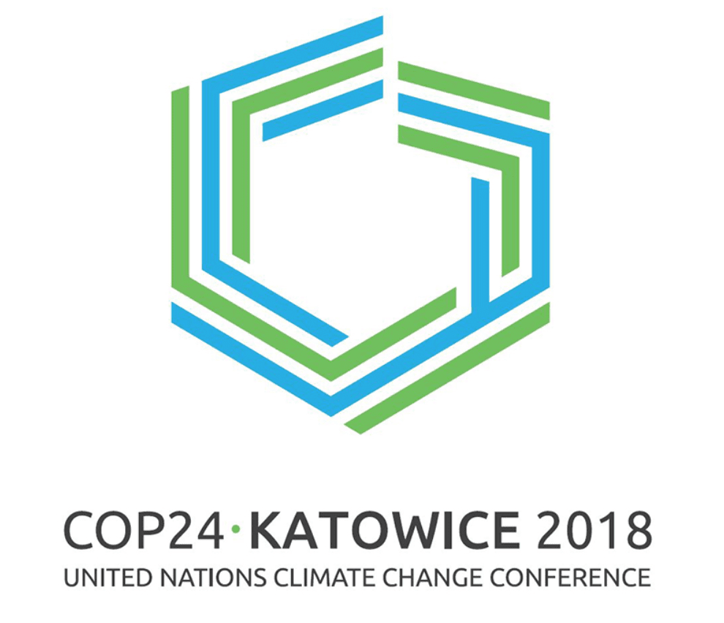


Key Outcomes of Previous 3 COP Conferences
Parties to report their emissions and progress in reducing them every two years starting from 2024.
Developed countries commitment of $100 billion annually from 2020 to fund climate action in developing countries
196
The Katowice Rulebook was to be resolved at COP24 for putting the Paris Agreement into operation. This concentration was on settling most of the rulebook's components.
23,000
Total Delegate Participation
Total Nations Participation
Katowice Rulebook
Reporting
Financial Support
COP24 : Poland
Countries were unable to agree on the Paris Agreement's Article 6, which focuses on strategies for reducing climate change
Countries were unable to agree on standard deadlines for carrying out climate action programmes. Options were 5-year, 10-year, or a mix of either or both timeframes.
1124
Countries agreed to table their new and improved carbon curbing plans with 73 countries committed to Net zero emissions by 2050
27,000
Total Delegate Participation
Total Stakeholders committed to Net Zero by 2050s
Carbon Market
Non-Consensus of Art. 6
Climate Action Plan
COP25 : Spain
151 nations had filed new climate plans known as nationally determined contributions, or NDCs, at the end of COP26 that called for them to cut their emissions by 2030.
The main goal of COP26 to achieve consensus was attained among the signatories to the Paris Agreement on NDCs to reduce emissions.
22,274
120
In order to make the 2020s a decade of climate action and support, nations formed the Glasgow Climate Pact.
Total Delegate Participation
Total Nations Participation
Glasgow Climate Pact
New Climate Plans
Katowice Agreement
COP26 : UK and Ireland

Slide 7





COP27 : An Overview
Key Goals of discussions at COP27 Conference
Mitigation
All parties are focused to adopt bold and rapid actions and reduce carbon emissions in order to keep global warming far below the 2°C.
Achieve "critically needed progress" at COP27 in order to help the world's most vulnerable populations and improve climate change resilience.
Finance
Make considerable strides in the area of climate finance, particularly delivering the annual $100 billion in aid committed to developing nations.
Collaboration
Adaptation
Since the UN discussions are consensus-based, everyone involved must actively participate to reach a consensus.
The 27th United Nations Conference on Climate Change, also known as COP27, will take place in Sharm El Sheikh, Egypt, from November 6 to 18, 2022. More than 90 chiefs of state and ambassadors from 190 nations are anticipated to participate, and it will be presided over by Egyptian Foreign Minister Sameh Shoukry.
Key Mechanisms and Action of Climate Support to be discussed at COP27
Financing Mechanism
Finance towards loss and damage from climate change
Finalization / Adoption of National Adaptation Plan and NDCs
National Targets
Revisit and Strengthen 2030 Emission Targets
Climate Finance
Adaptation Support
Global Stock take
Continuation of USD100bn financial commitment
Innovative formats of collective progress communication towards political support as an agenda

Slide 8
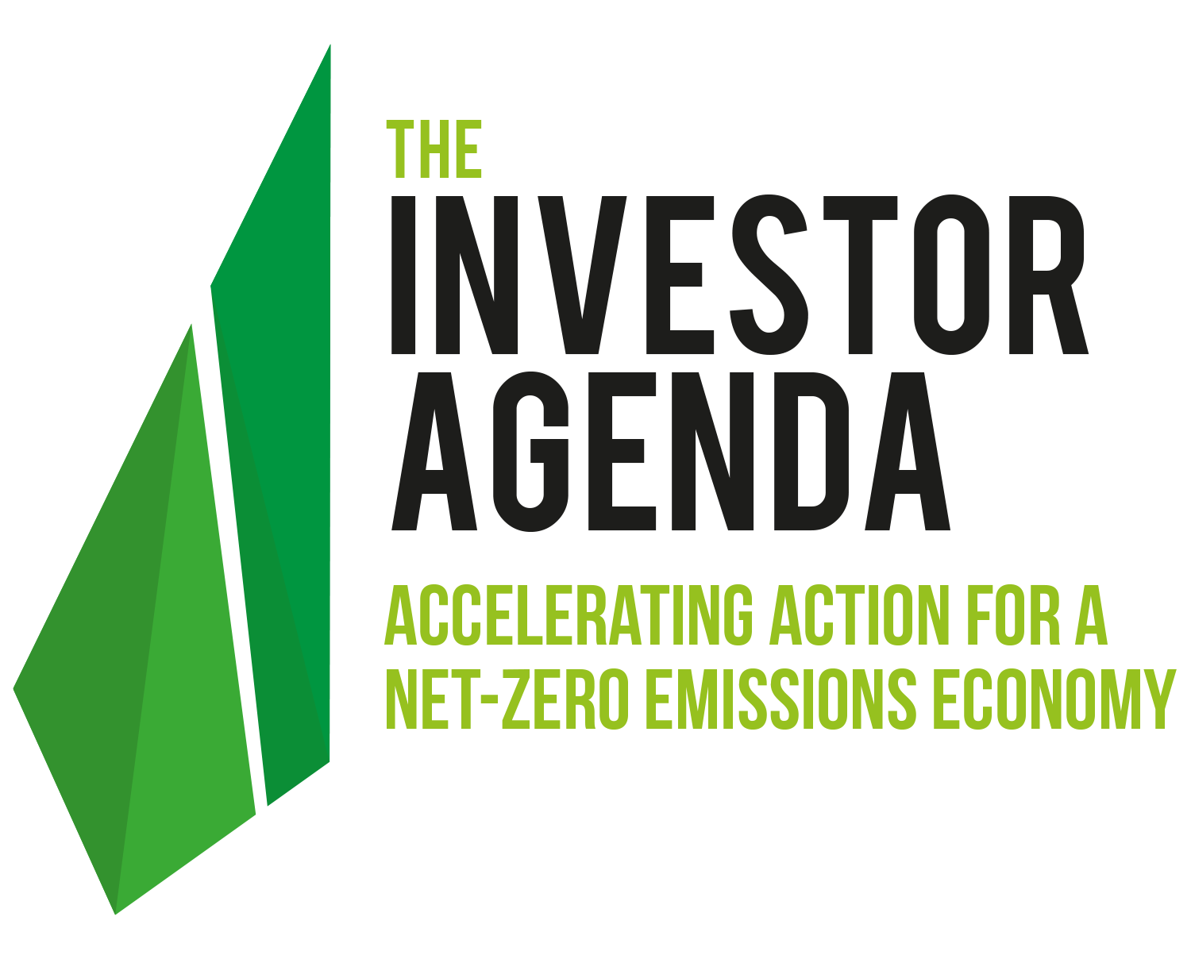






Significance of COP27 for Investors
Investors are pledging to go net-zero, incorporating science-based net-zero goals and strategies into their portfolio decisions, by presenting Investor Climate Action Plans, encouraging businesses to reduce their emissions and create transition plans, and urging policymakers to take strong climate action. This is being motivated by fundamental fiduciary duty to reduce our exposure to climate risk as well as by the potential benefits of moving toward a net-zero emissions economy.
Before COP27, 602 investors representing about US$42 trillion in AUM signed the 2022 Global Investor Statement to Governments on the Climate Crisis. The Key asks by the Investors are as seen above
NDC
2030 targets in NDCs to align with the goal of limiting global temperature rise to 1.5°C.
Policies
Placing internal measures such as carbon pricing systems and a timeframe to phase out fossil fuel subsidies
Non GHG Emission Reductions
Climate Finance
Climate Transition Plans
Lowering of non-carbon dioxide greenhouse gas emissions to support the Global Methane Pledge's successful implementation
Public and private sector funding for climate change for resilience, adaptation, and mitigation, with a focus on the needs of developing nations.
Enhancing climate disclosures in the financial sector, including transition strategies.
Investment
Investors should consider a climate strategy while also considering the social effects of the transition across all asset classes.
Key Climate Action / Transition Plan Elements
Investors must make sure that all employees, including the Board and senior management, are trained on just transition issues and/or have a working understanding of them.
Governance and Public Advocacy
Corporate Engagement
Investor expectations for corporations should only include transition-related elements when they ask for disclosure and transition planning.

Slide 9
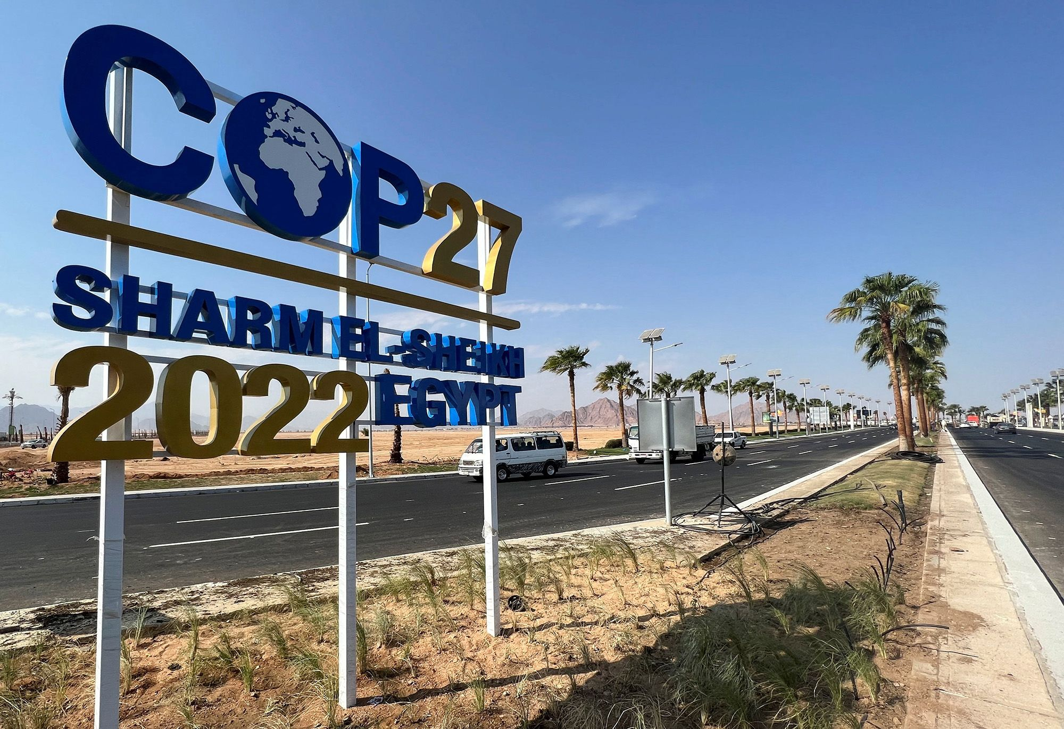
Themes of Discussion at Conference of the Parties (CoP) – 27th Edition : Egypt
03

Slide 10







Key Thematic Areas of Discussion for COP27
The Climate Finance Ecosystem will be the focus including but not limited to innovative and mixed finance as well as financial mechanisms, tools, and policies that could improve access, scale up financing, and aid in the transition.
26
198
Total CoP27 Meetings
Total Nations Participation
Finance
Science and Decarbonization
Youth and Future Generations
Adaptation and Agriculture
Gender, Ace and Civil Society
Water and Energy
Biodiversity and Solutions
Ocean ecosystems, coral reefs, endangered species, and the ability of protected areas to continue providing ecosystem services to global population.
Academia action to combat climate change, including methodologies and policies, and to highlight innovations of low carbon economy.
Drought, early warning system enhancement, and sustainable management of water resources as well evolution of energy ecosystems across the globe.
Interaction with policy makes and practitioners as well as a dialogue with the High-level Champions and non-party stakeholders.
prospects for multi-stakeholder partnerships, for civil society's participation and contribution in this sector and generally in various climate action and policy responses.
Focus on food security, improved resilience and livelihoods for small-scale farmers, increased agricultural output, decreased losses in the food production chain

Slide 11






Thematic Discussions on Finance at COP27
Key Climate Finance discussions to be held at COP27 Conference
Current State of Progress in Committed Climate Finance
Resilience Financing
Discussion on commitment to mobilize $140 to $300bn of investment that will be needed across both public and private sources towards adaptation and resilience requirements
Public Finance Policy
Mandated discussions towards mobilizing sustainable finance tools, sovereign debt allocation and access to low-cost financing which also includes commitments to reduce cost of green loans focusing on Nature Solutions and Climate Change
Discussions on addressing financial requirements towards adaptation and resilience to the current climate change trend by bringing in focused plans and project adaptation as part of bankability
Discussions on special financing tools by mitigating possible roadblocks of private green financing to increase bankability of projects
Discussion on strengthening climate finance as part of reporting, taxonomy formation, incentivization and anti - greenwashing
Discussion and initiative formation towards guidebook formation focusing on Just Financing initiatives by acknowledging loss and damage finance
Adaptation Financing
Private Climate Transition
Regulatory Establishment
Financing Guidebook
The most recent reports by Organization for Economic Co-operation and Development's (OECD) analysis, represented of providing developing nations with $80 billion in climate finance in 2019, up from $78 billion in 2018. Most of this money came from public grants or loans, transferred either from one country to another directly, or through funds from multilateral development banks (MDBs).
Source : Climate Finance Fund

Slide 12






Thematic Discussions on Science at COP27
Key Climate Science discussions to be held at COP27 Conference
Current State of Progress in Climate Science Innovations
IPCC Implementation
Discussion on latest IPCC report to focus on advances in Climate Science and impacts of climate change ecosystems across the global nations.
Climate Science Research
Development focused discussion towards formation of Global scientific hub to work upon climate change research alongside implementation of collaborative actions with academic institutions
Discussions on addressing potential approaches and protocols for future tangible impacts of biological and non biological diseases towards optimization of health ecosystem
Discussions on special scientific evidence-based climate change aspects across Africa in past 3 decades with focus on impact and magnitude
Launch of an initiative focusing on research and development of climate change technologies with multiple universities towards SDG achievement
Discussion towards development of special machine learning models of spatiotemporal analysis of coral reefs with special discussion on dust particles-based regulations for multiple systems of climate requirements.
Sustainable Health
African Climate Resilience
Innovation for Climate
Critical Natural Habitat Tech
Around 1,400 investors worldwide are interested in the upcoming crop of climate change-related businesses. Over 600 agreements totaled more than $40 billion in capital deployment, which is more than twice as much as the previous year. Great food and water tech businesses are in a distant third place, with the mobility and energy sectors continuously raising the most money.
Source : Climate Tech VC

Slide 13


Thematic Discussion on Youth & Future Generations at COP27
Key Climate Science discussions to be held at COP27 Conference
Current State of Inclusion of Youth and Future Generations towards Climate Change Aspects
Intergenerational Policy - I
Discussion on possible policy implementation and future dialogue towards transformative adaptation focusing on multiple elements of resilience, loss and damage, financial support by having a detailed discussion at initial levels with policymakers
Intergenerational Policy - II
A solution-based dialogue / discussion to have a Just transition alongside having a climate resilient technology and low emission integrations
Accelerating the integration and application of climate change education as part of its work on Education for sustainable development will be one of UNESCO's primary goals (ESD). The four action areas that have received the most attention are: greening communities; learning; capacity & readiness; and schools.
0.5 Million
Total youth that acted on climate change through SGP through houses and communities
84%
Youth expecting more inclusive and detailed education on climate change
73%
Current young generation feeling the climate change effects
Ministers are urged by COP President Alok Sharma to take young issues into account when negotiating at the COP and taking national climate action.
UK – COP26
2021
23 nations have made commitments to national climate education plans that include net-zero schools and placing the environment at the center of national curricula.
Source : United Nations, WEForum

Slide 14






Thematic Discussion on Decarbonization at COP27
Current State of Progress across Globe focusing on Decarbonization
Key Decarbonization discussions to be held at COP27 Conference
The biggest ever drop in CO₂ emissions occurred in 2020, when they fell by 5.8%, or about 2 Gt CO₂, nearly five times more than the decline that occurred in 2009 after the global financial crisis. Due to the pandemic, which impacted demand for oil and coal more than other energy sources, CO₂ emissions decreased more than energy demand in 2020, while renewable energy sources soared.
Steel Decarbonization
Discussion towards supporting and bringing in new initiatives focusing on decarbonizing steel operations across the globe by bringing in force to previous initiatives as well
O&G Decarbonization
The multiphase discussion of technology and policies with an effort to support towards multiple energy storage technologies for O&G sector operations as part of future collaboration efforts.
Discussions on addressing potential pathways of green fertilizers to bring in better food security and agricultural sector decarbonization through new technological collaborations
Global pledge-oriented discussions focusing on technological and process improvisations towards methane leak cuts and methane venting with efficient financial models
Multi sector-oriented discussion with private and public partnership entities to have an evolution of policy towards decarbonizing the cement operations alongside acceleration discussions on current technologies.
Discussion towards accessibility of resources for low carbon pathway of cement production for African Region and Global South Nations with new initiatives of sustainable pathway development
Fertilizer Decarbonization
Global Methane Pledge
Cement Decarbonization
Low Carbon Developments
Source : IEA

Slide 15






Thematic Discussion on Adaptation & Agriculture at COP27
Current State of Progress across Globe focusing on Agricultural Adaptation
Key Agricultural Adaptation discussions to be held at COP27 Conference
FAST and iCAN
Intiaitve and Action based collaboration with multiple stakeholders towards generation and mobilization of climate finance on agriculture and food systems. This focus would help upon both Nations and Non-Nation entities to mobilize financing.
Ministerial Initiative
The multiphase discussion on KJWA Ministerial Panel with a focus upon reaching a consensus towards vulnerability assessment and impact assessment across developing and developed nations through financing and technology
Discussions on addressing new methodology to communicate progress on current adaptation measures with comprehensive monitoring of progress which can fund further investments to support national action plans.
Global technology-oriented discussions with possible collaboration with multiple entities towards development and implementation of flood resilience and insurance tools.
Multi sector-oriented investment discussion for private sector entities and telecommunication entities for climate smart agriculture technology deployment and development
Discussion towards accessibility of low-cost financing solutions for sustained agricultural needs with new technology investment being part of technology funding.
Monitoring Progression
Adaptation Technologies
Private Sector Collaborations
Financing Climate Smart Agri
Sustainable agriculture has been part of the climate solution because it accounts for 25% of the world's greenhouse gas emissions and uses 50% of the world's vegetated land and 70% of its fresh water. By 2050, sustainable agriculture could feed a population of 10 billion people while also being the next big investment opportunity.
Source : OECD

Slide 16






Thematic Discussion on Water Stewardship at COP27
Key Water Stewardship discussions to be held at COP27 Conference
AWARE
Early
Warning
Focused and Important discussions focusing on implementation of the UN Secretary General Early Warning Initiative which includes key risks of Water scarcity and Flash Flood protection
River Basin
Systems
Case study-based discussion with multiple stakeholders on Nile River based Geospatial Earth Monitoring Systems as part of computational analysis within the river streams
Detailed 5 Panel discussions focusing upon limitation of water scarcity, digitization solutions, water efficiency development and water recycling efforts for technological / solution collaborations
Discussion towards identification of delta zone protection measures which also includes direct physical hard barricading protections for the cities. This would be intended towards diversion of certain climate financing funds for costal protection
Pre-UN-Water 2023 Conference illustrations to be discussed focusing on current progress and leading outcomes in the current decade by Leader of Water Conferences
Water
Security
Sea Level Rise
Solutions
Water Action
Decade Review
Partnership with World Meteorological Organization to adopt political contribution requirements across multiple aspects of water management systems towards field systems deployment
Current State of Progress in Investment across Globe focusing on Water Stewardship
USD 28.3 Million
USD 67.86 Billion
Cumulative Environmental Impact Bond Issuance for Water Security in 2017-19 : USA
Cumulative Green Bond Issuance for Water Security in 2017-19 : USA
USD 498 Million
USD 1.5 Billion
Cumulative Hydro bonds Issuance for Water Security in 2018-20 : Italy
Cumulative Sustainability Awareness Bond Issuance for Water Security in 2018-20 : EU
Source : OECD

Slide 17





Thematic Discussion on Energy at COP27
Key Energy Transition discussions to be held at COP27 Conference
Current State of Global Progress towards Energy Transition
African Just and Affordable Energy
Initiative based discussion and launch focusing on bringing in collaboration towards affordable energy transition across the African region with technology and low-cost finance
Clean Energy
Discussion on pathways from fossil fuels across the globe with a focus on long term strategy for future low carbon economy development
Discussions on addressing technological and financial requirements focusing on development of low-cost energy systems, battery storage and smart grids and scale up the solutions
Discussions on bringing in policymakers, financial lenders / investment instruments with technology stakeholders to enable development and deployment of hydrogen energy solutions
Discussion on strengthening climate finance as part of blended finance partnership, just energy transition and other instruments towards new / ongoing energy deployments
Discussion and initiative towards impacts and assessments of national / global level policies focusing on clean energy deployment
New Energy Systems and Technologies
Green Hydrogen
Financing Clean Energy
Policies Implementation
The electrified transportation increased the fastest, reaching $273 billion (up 77%), and was the largest sector in 2021, attracting $366 billion for new projects and small-scale systems (up 6.5% from 2020). Nuclear energy received $31 billion in spending while electrified heat received $53 billion.
Source : BloombergNEF

Slide 18






Thematic Discussion on Biodiversity and Solutions at COP27
Current State of Global Progress in Biodiversity and Nature Solutions
Key Nature Solution discussions to be held at COP27 Conference
Currently, the nations are investing in Nature solutions for over USD 133 billion each year. Most of the investment, i.e., approx. USD 113 billion, is made by domestic government organizations for the protection of biodiversity and landscapes, along with other initiatives like sustainable forestry. The business sector makes an additional USD 18 billion annually, primarily from investments in environmentally friendly supply chains.
Biodiversity Nexus
Discussion towards supporting and bringing in new scientific based knowledge solutions focusing on creating and ecosystem of mitigation and adaptation
Nature Solutions
The multiphase discussion by launching a focused initiative on nature-based solutions which majorly concentrates upon the biodiversity management
Critical discussions on addressing potential policymakers and other technology / nontechnology oriented stakeholders towards Glasgow Declaration of Forests which would be a pre illustrative discussion on CBD 15 - COP15 Part 2.
Global pledge-oriented discussions focusing on technological and process improvisations towards new low carbon transportation technology as a presidency initiative.
Multi sector-oriented discussion with private and public partnership entities to have an evolution of policy towards new nature solutiosn deployment and additional financing by private sector entities
Discussion towards accessibility of Waste management resource systems across Africa and other Global South nations with possible collaboration towards action on ground projects
Urgent Action of Biodiversity
Sustainable Transport
Private Sector Climate Sol^{n}
Waste Solutions
Source : United Nations

Slide 19
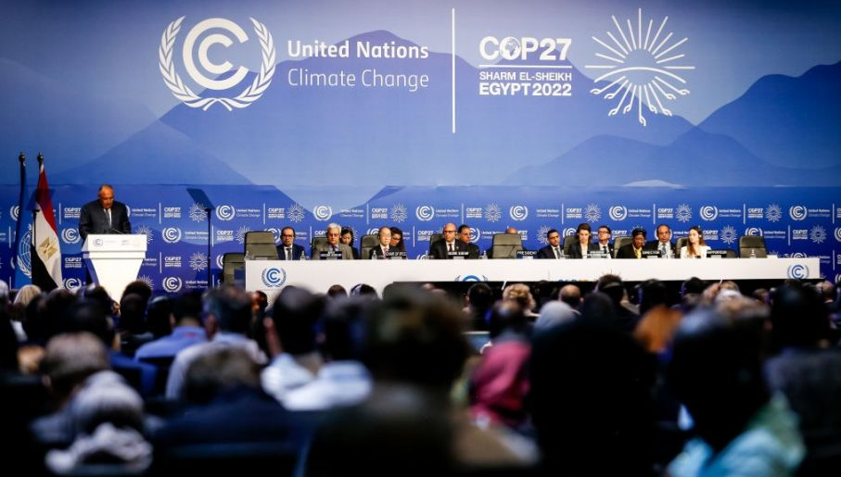
Key Commitments, Alliances and Outcomes at Conference of the Parties (CoP) – 27th Edition : Egypt
03

Slide 20


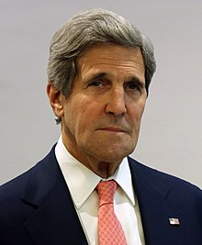



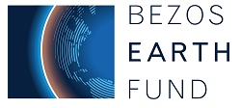
Key Commentary / Discussions on 6th – 7th Nov 2022
Middle East Green Initiative and KSA Sovereign Wealth Fund Commitment
Crown Prince Mohammed bin Salman of Saudi Arabia has made a climate commitment to contribute $2.5 billion to the Middle East Green Initiative over the following ten years which serves as the organization's home base. The crown prince announced in Sharm El-Sheikh, Egypt, as world leaders gathered for the COP27 climate change summit that the Public Investment Fund, the Kingdom's sovereign wealth fund, will similarly aim for net-zero carbon emissions by 2050. The Middle East Green Initiative, started by the crown prince last year, aims to cut carbon emissions from the production of regional hydrocarbons by more than 60%.
Key Initiatives under Wealth Fund
Committed to restore 200 million hectares of degraded land across the Middle East by planting 50 billion trees and by 2030, generate 50% of its electricity from renewable sources.
Key Outcomes from Initiatives under Wealth Fund
By 2035, the fund initiatives will have eliminated 44 million tons of carbon emissions with removal of a total 670 million tons of carbon dioxide equivalent across the initiative timeline and account for 10% of world contributions
Launch of Carbon Offset Plan by USA
Current Interested Parties
John Kerry, the U.S. climate envoy, proposed a Carbon Offset Proposal that would let businesses support renewable energy initiatives in developing nations that are having difficulty making the switch away from fossil fuels. The Rockefeller Foundation and the Bezos Earth Fund are partners in the initiative, known as the Energy Transition Accelerator. The strategy will establish a new class of carbon offsets that represent investments in initiatives that advance renewable energy initiatives or increase a developing nation's capacity to withstand the effects of climate change.

Slide 21





Key Commentary / Discussions on 6th – 7th Nov 2022
National Plans and Carbon Neutrality showcase by India
Only 29 of the 194 countries had submitted tightened national plans since COP26 in Glasgow. The UN Executive Secretary for Climate Change urged states to concentrate on three crucial topics at COP27 in his opening remarks.
The first is a fundamental shift toward putting the Paris Agreement into practice and turning negotiations into actual actions.
The second involves solidifying progress in the crucial workstreams of mitigation, adaptation, finance, and loss and damage while boosting funding, particularly to address the effects of climate change.
The third is improving how the UN Climate Change process applies the principles of accountability and transparency.
Bihar has turned to be the first state in India to showcase its carbon neutrality initiative across the country which was appraised at the COP27 Meeting by Arvind Kumar Chaudhary, principal secretary (environment forest and climate change) and S Chandrashekar, member secretary at Bihar State Pollution Control Board (BSPCB)
Introduction of UN Global Early Warning Systems
A plan to create a Global Early Warning System for extreme weather events made worse by climate change has been proposed by the World Meteorological Organization (WMO).
WMO announced on November 7, 2022, that the initial investment for providing early warning systems for everyone by 2027 will be close to $3.1 billion. It is comparable to just 50 cents (or around Rs. 41) per person per year, which is comparatively low. During a roundtable discussion at the 27th Conference of Parties (COP27) to the United Nations Framework Convention on Climate Change, the WMO announced the Executive Action Plan of Early Warnings for All. Following are the key pillars of focus towards establishing an early warning system :
Disaster Risk Knowledge
Observations and Forecasting
Preparedness and Response
Communication of Early Warnings
Hazard Monitoring Systems

Slide 22


















Key Commentary / Discussions on 8th Nov 2022
Global Offshore Wind Alliance Expansion
New Alliance Nations
Nine new nations have joined the Global Offshore Wind Alliance (GOWA), including Belgium, Colombia, Germany, Ireland, Japan, the Netherlands, Norway, the United Kingdom, and the United States. These nations have pledged to rapidly expand offshore wind in order to address the climate and energy security crises. The nations that have joined GOWA have committed to cooperating to advance national, regional, and international goals and remove obstacles to the deployment of offshore wind in both new and existing markets, with a goal of going beyond 2000 GW in 2050 from just over 60 GW at present.
Interim Target
380 GW installed capacity by the end of 2030
Green Hydrogen Partnership and Water Security Roundtable
At the COP27 in Egypt, President Hage Geingob of Namibia and Commission President Ursula von der Leyen signed a Memorandum of Understanding establishing a strategic relationship between the EU and Namibia. In order to promote the green and digital transformation of the partners' economy, the partnership intends to ensure the creation of a secure and sustainable supply of raw materials, processed products, and renewable hydrogen. As part of the EU's climate aspirations, it strengthens cooperation in areas where both sides stand to gain. It is also a win for Namibia, a leader in the continent's development of renewable hydrogen. The strategic partnership has been established focusing on multiple pillars, which includes the following :
Integration of sustainable value chain for renewables / hydrogen
ESG Criteria alignment and standard cooperation
Funding Mobilization for Soft and Hard infrastructure
Capacity Building and Knowledge Integration of hydrogen value chain
Research and Innovation of Hydrogen Technologies
Regulatory Alignment and Standardization

Slide 23
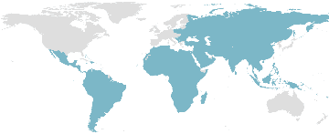




Key Commentary / Discussions on 8th Nov 2022
Financing Commitments and Projections
External Financing Projection by COP26 and COP27 Host Nations
Other Key Loss and Damage Financing Pledges by Nations
With its current commitment to increase climate finance to €225 million annually by 2025, Ireland has taken a cautious step toward providing "loss and damage" payments to poor countries suffering from climate catastrophes but classifying it as loss and damage was a crucial step. This would consider a plan for loss and damage, and Ireland would provide financial support.
By 2030, emerging market and developing nations would need to collaborate with investors, developed nations, and multilateral institutions to mobilize $1 trillion annually in external financing from private and public sources for these three areas of climate action, with the remaining funding coming from their own domestic private and public sources. Other than China, emerging market and developing nations are projected to have total annual investment needs of $1 trillion in 2025 and $2.4 trillion in 2030 with current investment standing at $500 million.
Austria's climate ministry has pledged €50 million to underdeveloped nations dealing with inevitable losses and harm brought on by climate change. It joins a select group of European countries in offering these funds. The funds could support the "Santiago Network," that offers technical assistance to nations suffering from the effects of natural disasters caused by climate change,
To address loss and damage in developing nations, New Zealand has committed a special investment of NZ$20 million in climate funding. It fulfils promises to address climate change effects that aren't covered by funds for adaptation strategies.
Loss and Damage Compensation
The First Minister of Scotland has created a $5 million fund to address the loss and harm brought on by climate change in poor nations. Following the £2 million pledged during the summit in Glasgow the year before, Nicola Sturgeon confirmed an increase in financing from Scotland. On her second day at the Sharm El-Sheikh summit, the First Minister announced an increase in spending, with funds coming from the Scottish Government's climate justice fund.
The Early Warnings for All Executive Action Plan calls for initial new targeted investments of US$ 3.1 billion between 2023 and 2027, a sum that would be dwarfed by the benefits. This amounts to a tiny portion (roughly 6%) of the $50 billion in adaptation financing that has been requested.

Slide 24
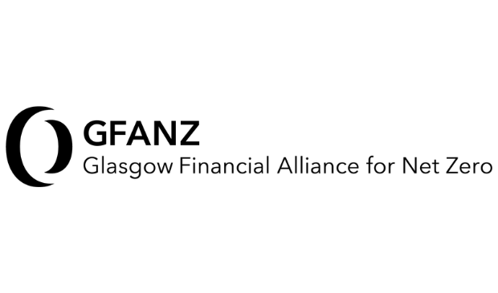


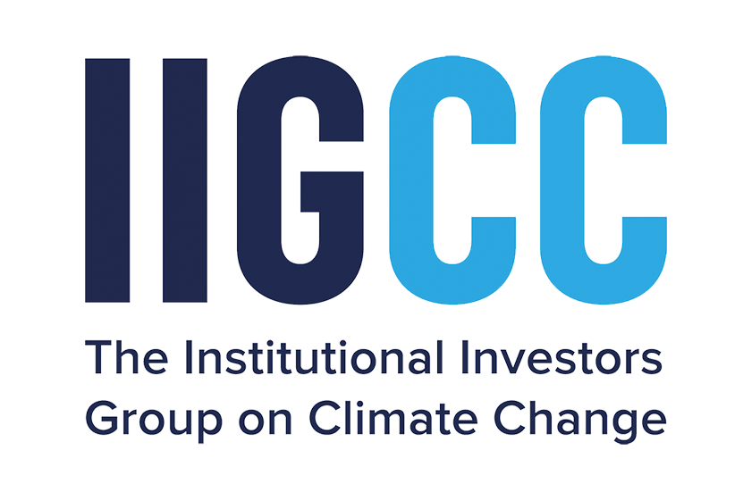
Key Commentary / Discussions on 9th – 10th Nov 2022
Key Assets and Alliance Stocktake across Globe
GFANZ is a worldwide alliance of top financial institutions dedicated to speeding and mainstreaming the transition to a low carbon of the international economy and achieving net-zero emissions by 2050. To address common issues and advance best practices throughout the industry, GFANZ unites seven financial sector net-zero organizations, each representing more than 500 members as part of aligning with United Nation’s commitment to Net Zero by 2050.
~160 New Asset Owners
USD 70 Trillion of New Asset Value
A global group of banks that collectively account for 40% of all global banking assets have joined the industry-led, UN-convened Net-Zero Banking Alliance in an effort to align their lending and investment portfolios with net-zero emissions by 2050. This ambitious commitment requires signatory banks to use strong, scientifically based guidelines to set intermediate targets for 2030 or earlier, combining near-term action with accountability.
122 Banking Signatories
At COP27, the UK vowed to fulfil its commitment to provide $13.4 billion in international climate finance in 2019. The UK has been contributing £65 million to environmental programmes in Kenya, Egypt, and other countries. By 2025, funding for these so-called adaptation projects is expected to increase threefold to £1.5 billion. The UK currently invests about £10 billion annually, but the nation's net-zero plan calls for annual investments of £50 billion ($57.9 billion) until 2030.
USD 13.4 Billion
USD 115 Million
International Climate Finance and Loss and Damage Commitment
The PAAO presented its Inaugural Progress Report as part of COP27, showcasing asset owners' creativity and best practices for putting their pledges to net zero into effect. Since March 2021, 40 asset owners have declared initial targets, which includes the new targets. The 57 signatories who make up the Paris Aligned Asset Owners collectively represent over $3.3 trillion in AUM. Targets from asset owners including AP7, Lloyds Banking Group Pensions Trustees Limited, and Ilmarinen are among the most recent announcements.
13 New Asset Signatories

Slide 25




Key Commentary / Discussions on 9th,10th and 11th Nov 2022
Climate Reporting Transparency Adoption
CDP Incorporation of ISSB in Global Disclosure Platform
Numerous smaller developing nations' lack of transparency because they lack the reporting infrastructure. It might make more sense to report mostly on loss and damage and what funding is required for climate change in small countries that may only contribute 0.1% to global emissions.
However, the mandated reporting does not include these components. The transparency strategy has a drawback in that many actions are challenging to quantify. One of the most important categories of climate action is adaptation, but it is challenging to quantify.
To ensure that the transparency requirements of the Paris Agreement do not unduly burden poor nations, particularly those with very low emissions, Instead, the policy should give priority to and promote reporting on topics vital to these nations, like adaptation, climate change loss and damage, and financing requirements.
The ISSB Climate-related Disclosures Standard will be incorporated by CDP into its global environmental disclosure platform. This integration means that ISSB climate data disclosure will be quickly adopted across the global economy, improving the consistency of climate-related information for investors and easing the burden of disclosure on entities through an alignment of requirements.
By decreasing the reporting burden on organizations and hastening the early adoption of IFRS S2 disclosures, investors would receive the consistent climate-related information they require sooner.
The Standard, which is currently being finalized, will be incorporated into CDP's current questionnaires, which are sent out annually to businesses on behalf of 680 financial institutions with a combined asset base of more than $130 trillion.
Sustainable Agriculture Financing Commitment
$8 Billion aimed at reducing the impact of farming on the planet
The funding made public at the COP27 climate summit in Egypt will support 22 more initiatives and virtually treble the investments made since the Agriculture Innovation Mission for Climate was revealed a year ago. These include initiatives to increase Africa's rain-fed agriculture, track methane emissions from rice fields, and increase Dubai's vertical farming.
$109 Million Climate Funding for Nigerian Farmers
To assist Nigerian farmers in adjusting to the effects of climate change while increasing output in the continent's most populous nation, the UK government will grant fresh assistance. The UK government is contributing £95 million ($109 million) to a scheme that will scale up sustainable farming methods for 4 million farmers, including 2 million women.
USD 8 Billion
275
USD 109 Million
Heat and Flood Tolerance
Green Farming Investment Value at COP27
Leading Nations under Financing Commitment
Total Nations, Entitles and Institutions committed to funding
UK’s Investment Value at COP27
Leading Nations under Financing Commitment
Funding Focus under the Commitment

Slide 26






Key Commentary / Discussions on 11th Nov 2022
Breakthrough Agenda for Decarbonization and Actions Committed at COP27
Over half of the world's governments have outlined a 12-month action plan to help make clean technologies more affordable and available worldwide. The nations announced a package of 25 additional cooperative activities to be completed by COP28 in order to hasten the decarbonization process in the areas of power, transportation by road, steel, hydrogen, and agriculture. Three COP Presidency's historic support for COP26, COP27, and COP28 propels implementation from Glasgow to Sharm El Sheik and into the COP hosted by the United Arab Emirates and signals an intent to the corporate sector.
The Breakthrough Agenda is a ground-breaking international clean technology plan that aims to make clean technologies and sustainable solutions the most accessible, affordable, and alluring option in all regions by 2030. It does this by combining the tools of government with business and financial ingenuity through a coalition of leading public, private and public-private global initiatives.
The first set of government-led Breakthrough objectives, dubbed the "Glasgow Breakthroughs," were unveiled at COP26 and focused on five major industries that collectively account for more than 50% of global emissions. With the introduction of new Breakthroughs in new sectors, more nations are stepping up to take the initiative. Additionally, there are business-led commitments like the 2030 Breakthroughs that support the goals of the Breakthrough Agenda.
Low / No Emission Energy Resource Production
To help direct billions of pounds in investment, procurement and trade to ensure credibility and transparency
Net Emission Infra Deployment
50 Net-zero Emission Industrial Plants & at least 100 H₂ valleys and a major cross-border power grid infrastructure
Vehicular Phasing Out
A common target date to phase out polluting cars and vehicles, consistent with the Paris Agreement.
Focus upon public procurement and infrastructure spend to stimulate global demand
Developing Nations Climate Support
Sustainable Agriculture Oriented R&D
Green Industrial Goods
Strengthen financial and technological assistance to developing countries to support their transitions with Climate Funds
Drive investment in agriculture RD&D to generate solutions to address the challenges of food insecurity
$410m Green Hydrogen investment in Egypt led by the EBRD
World bank aided $1.6bn Green Hydrogen Global Programme

Slide 27









Key Commentary / Discussions on 11th Nov 2022
Key Alliance and Development Initiatives committed under Breakthrough Agenda at COP27 to achieve the actions
Agriculture Breakthrough at COP27
Buildings and Cement Breakthrough at COP27
UAE Commitment to Breakthrough at COP27
Australia, Cambodia, Germany, and Ireland are among the 13 nations that have signed on to the Agriculture Breakthrough initiative, which is being co-led by the UK and Egypt and aims to make climate-resilient, sustainable agriculture the most popular choice by 2030. Following are the leading signatories :
Cambodia became the latest nation to endorse the Breakthrough Agenda as a whole, bringing the total number of nations endorsing the agenda to 47. France and Morocco have signaled their intention to launch a new Buildings Breakthrough; Canada have signaled their intention to launch a new Cement Breakthrough in 2023.
The recent 100 GW Partnership to Accelerate Clean Energy (PACE) with the United States and the 10 GW wind power agreement signed with Egypt at COP27 are recent examples of this commitment by the UAE, founding members of AIM for Climate.
In this crucial decade, the Breakthrough Agenda is driving decarbonization efforts in the world's most significant economic sectors. Through the First Movers Coalition, the public and private sectors may work together to scale important innovations and open new markets. Numerous advancements in business and government-led initiatives, together with major announcements made throughout COP27, are assisting and accelerating these priority activities.
The First Movers Coalition has expanded to 10 new corporate members to reach 65 in total with a combined market cap of about $8 trillion.
The First Movers Coalition also launched its cement and concrete sector
Launch of the Climate Investment Funds’ (CIFs) new Industry Transition Programme
Plan to launch CIFs Capital Market Mechanism that will generate billions of dollars a year in extra finance into sector transitions
MPP, an alliance of leading climate organizations, released 2030 Milestones for seven hard-to-abate industrial and transport sectors
The Africa Net-Zero Concrete Group has launched and the first African Net-Zero Concrete National Roadmap

Slide 28




Key Commentary / Discussions on 11th Nov 2022
United Nations Technological Monitoring
“The Methane Alert and Response System is a big step in helping governments and companies deliver on this important, short-term climate goal”
Inger Andersen
Executive Director of the UN Environment Program
As part of a new initiative to persuade businesses and governments to reduce their emissions of the potent greenhouse gas, the United Nations' (U.N.) environmental watchdog will establish a public database of methane leaks discovered by space satellites. The Methane Alert and Response System will be based on a commitment made by 119 nations since last year to reduce methane emissions by 30% over the next ten years. The system will communicate information about leaks to those responsible in the hope that they will discover the source of the leak and fix it.
Before progressively extending to include other industries including coal, garbage, cattle, and rice, the system will initially concentrate on international oil and gas activities, which are among the major emitters of methane. The project will get funding from the governments of the United States and the European Union as well as charity groups like the Global Methane Hub and Jeff Bezos' Bezos Earth Fund.
Disclosure Practices Stringency Commitment
The US Administration proposed the Federal Supplier Climate Risks and Resilience Rule at COP27 as an agenda towards climate transition foundation, wherein the largest suppliers, including Federal contractors receiving more than $50 million in annual contracts will have to publicly disclose their Scope 1, Scope 2, and relevant categories of Scope 3 emissions.
This disclosure also needs to include their financial exposure to climate-related risks and establish science-based emissions reduction targets.
Public reporting of Scope 1 and Scope 2 emissions would be necessary for federal contractors with yearly contracts worth more than $7.5 million but less than $50 million.
A sizable and cross-party majority of the JURI committee of the European Parliament has endorsed its stance on the EU Corporate Sustainability Reporting Directive (CSRD). After this vote, the CSRD proposal will proceed to the legislative process' final phase and begin trialogue negotiations with the EU Commission, European Parliament, and Council at COP27
One of the key tools for ensuring the successful implementation of the EU Green Deal and Sustainable Finance agenda—the road map that needs to be sped up to transition away from the production and import of fossil energy resources—is the CSRD and the related EU standards.

Slide 29












Key Commentary / Discussions from 12th - 14th Nov 2022
Sustainable Food and Climate Adaptation Focus
Climate Commitment Display by Govt of India
Launch of the FAST Initiative
Administration of Kolkata
Administration of Maharashtra
Indian Oil Corporation Limited
The UN FAO and the COP27 Presidency inaugurated the Food and Agriculture for Sustainable Transformation (FAST) initiative to boost financial support for the food and agricultural sectors to improve access to financing, supplying knowledge and capacity, and promoting preferential policies and conversation that adhere to NDC, NAP, or Long-term Low Emissions and Development Strategies
The Government of Maharashtra presented its Majhi Vasundhara Project aiming towards achieving Net Zero emissions to inform people about the effects of climate change and environmental problems and to inspire them to actively work to improve the environment which will assess potential investment opportunities over the coming months in order to drive its economy toward net zero.
Indian Oil Corporation Limited discussed its activities on biofuels, sustainable solar-based cooking, carbon-efficient refining technology, and energy transition. The business also talked about India's efforts to expand its portfolio of biofuels, compressed biogas (biomethane), biodiesel, and sustainable aviation fuel alongside outlining its objectives and strategies for achieving net-zero by 2046.
Kolkata had presented its climate support report as part of its advancement towards city's efforts to combat climate change, vulnerability, mitigation and adaptation measures to become amongst the few cities within the Climate Action Network South Asia. The meeting was attended by representatives from several South Asian cities.
African Climate Adaptation Finance
Long Term Emission and Development Strategies (LT-LEDS) : 2022
USA and Egypt jointly launched a significant adaptation aid package worth over USD 150 million. In order to close the adaptation gap and boost the resilience of 4 billion people, this agenda includes 30 global adaptation outcome targets by 2030. These targets will be achieved through speeding transformation across five impact systems.
India now joins the elite group of less than 60 nations that have provided the UNFCCC with their long-term plans. The Ministry of Environment, Forest and Climate Change had comprehensive consultations with all relevant Ministries and Departments, State Governments, academic institutions, and civil society organizations before developing the strategy. Seven crucial shifts to low-carbon development paths form the foundation of India's LT-LEDS.
Energy Sector
Renewables Expansion and Low Carbon Technology Support
Green Taxonomy and Energy Mix Optimization
Transportation Sector
Improved Fuel Efficiency and Clean Fuel Transition
Intelligent Transportation Management and Electrification
Urban Design Sector
Industrial Sector
CCUS Technologies
Forestry Sector
Low Carbon Development
Climate Resilient Design of Infrastructure
Low Carbon Pathway based Resource Management
Natural and Bio Based Resource Efficiency
Green Hydrogen Implementation and Sustainable MSME Integration
New and Improvised Exploration Efforts
Financing and Capacity Building Interventions
Conservation and Management of Forests
Infrastructure and Upgradation of Forrest Reserve Management
Climate Specific Financing
Technology Transfer and Multilateral Mechanisms
US DOA Climate Smart Practice Funding
USD 300 million has been announced by USDOA for climate-smart agriculture initiatives, increasing the total commitment to $3.1 billion towards 65 additional initiatives which will concentrate on small and underserved farmers and techniques for measuring, documenting, and verifying the advantages of climate-smart projects.

Slide 30








Key Commentary / Discussions from 14th - 15th Nov 2022
AWCAP Initiative and US AID GEEA
Egypt launched the African Women's Climate Adaptive Priorities (AWCAP) initiative. This Programme was inspired by the crucial realization that women and children make up 80% of individuals in need of aid after a disaster, while poor women in rural regions have a 14-fold higher mortality rate.
Beyond its $14 million COP26 contribution, USAID committed $21.8 million from the Gender Equity and Equality Action (GEEA) Fund dedicated to gender-responsive climate action. This initiatives address gender-based violence linked to the climate, assistance to national governments to increase gender equality in their national climate commitments, and initiatives to advance women's access to green jobs and gender-sensitive climate information services.
Rainforest Protection Pact
AJAETI
The Africa Just and Affordable Energy Transition Initiative was launched focusing on three main goals are to provide access to clean cooking fuels and technology, boost the share of renewable electricity generation by 25%, and provide technical and policy support to enable affordable energy for at least 300 million people in Africa by 2027. This would present Africa with a unique chance to advance its Agenda 2063.
Brazil, Indonesia, and the Democratic Republic of the Congo, the three nations that account for more than 50% of the world's tropical rainforests, have agreed to cooperate to create a funding mechanism that could aid in protecting the forests.
These play an important role in regulating the planet's climate and are home to a variety of animals, plants, birds, and insects. As a result, it would be easier to work together on sustainable management and conservation, the restoration of important ecosystems, and the development of economies that would guarantee the wellbeing of both people and forests.
UN Joint Work Programme
In order to support climate technology solutions in developing nations, the UNEP and the UNFCCC introduced a new five-year work Programme at COP27. This joint work programme was launched by the UNFCCC's Technology Executive Committee and the Climate Technology Centre and Network, the two organizations that make up the Technology Mechanism, to hasten the adoption of the transformative climate technologies that are urgently needed to combat climate change.
In order to support towards continual implementation of the Joint work programme, multiple nations across the global have committed financial support to the programme. Following are the financial aids committed :
USD
3 Million
EUR
2 Million
EUR
2 Million
CAD
6 Million

Slide 31



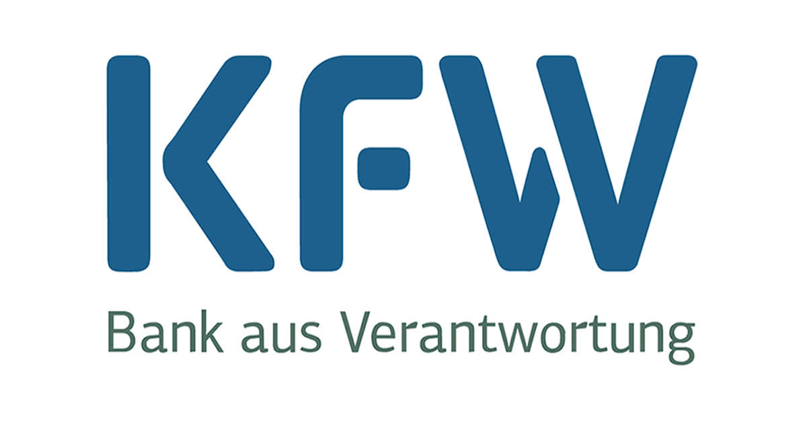
Key Commentary / Discussions on 16th – 19th Nov 2022
SLCP and Financing Commitments
CCAC and UNEP Collaboration towards SLCP Reduction
Global Shield and Global Risk Modelling Alliances (GRMA)
The G7 and the Vulnerable 20 Group of Finance Ministers (V20) comprising 58 climate-vulnerable economies launched the Global Shield which aims to provide pre-arranged financial assistance that may be mobilized in the event of a climate emergency. Germany's initial contributions comprise ~ EUR 170 million in seed money, of which EUR 84 million serves as the Global Shield's core funding and EUR 85.5 million goes toward associated climate risk finance instruments. Additional fundamental financing commitments to the Global Shield include sums of EUR 4.7 million euros from Denmark, EUR 10 million euros from Ireland, CAD 7 million from Canada, and EUR 20 million from France.
The Ministers from Belgium, Japan, Monaco, Norway, and the United States of America made new pledges to the CCAC Trust Fund totaling USD 5.75 million, and they urged other nations that were able to do the same to do so. While CCAC co-chair, the USA, announced its intention to provide USD 3 million to the Climate and Clean Air Coalition, subject to Congressional notification and the conclusion of domestic procedures, Finland and the Netherlands indicated their intention to contribute additional funding to the Trust Fund.
Establishment of Loss and Damage Fund
Green Funds and Special Fund Commitments
On 19 November 2022, the COP27 concluded at Sharm al Sheikh, Egypt with all countries committing to the crucial Loss and Damage Climate Fund, the first ever focused and committed fund established towards committing financial support towards underdeveloped nations by developed nations across the globe.
This was won over the 27-nation European Union and the United States, which had long resisted the idea for fear that such a fund could open them to legal liability for historic emissions.
This was one of the first such emergency climate funds established on a global scale with continuous efforts from G77 Developing nations in the last 30 years.
The package also boosted the financial, technological, and capacity-building assistance that developing nations need to reduce their emissions of greenhouse gases and adapt to their inevitable effects from climate change.
Through two new investment funds, Germany will make USD 572 million available to support the establishment of green hydrogen projects in poor nations. Grants will be granted along the full green hydrogen value chain, including storage and transport, with the two funds handled by German development bank KfW.
7 donor governments committed financial support for the Special Climate Change Fund and Least Developed Countries Fund with Denmark, Finland, Germany, Ireland, Slovenia, Sweden, Switzerland, and the Walloon Region of Belgium announced a total of USD 105.6 million in new funding and emphasized the need for even more support for the Global Environment Facility funds aimed at the immediate needs of low-lying and low-income states for climate adaptation.

Slide 32

Acuity’s Viewpoint on Conference of Parties 27th Meeting : 2022
04

Slide 33





Quantitative Overview of Alliances and Commitment at COP27
Key Loss and Damage Financing Commitments
USD
176 Million
USD
62 Million
USD
176 Million
USD
21 Million
USD
12 Million
USD
10 Million
USD
7 Million
USD
6 Million
USD
5 Million
Germany
EU
Austria
France
New Zealand
Ireland
Canada
Scotland
UK
Key Alliances and Initiatives Collaborated towards at COP27
Total Adaptation Financing Committed
Middle East Green Initiative
African Net Zero Concrete
Group
AJAETI
Africa Carbon Markets
Initiative
USD 230 Million
Global Offshore Wind Alliance
Agriculture Breakthrough Initiative
Green Hydrogen Global Programme
United Kingdom Exports
Forum
Key Reports Launched at COP27
Carbon Brief Analysis
Early Warnings for all Action Plan
Guidebook for Just Financing
Methane Emissions Report
Glasgow Climate Pact Progression
Yearbook of Global Climate Action 2022
2022 Global Carbon Budget
Forest Tenure Pledge Report
All in Pathway to 2030
Net Zero Pledge Report
Climate Vulnerability Monitor
Land Gap Report

Slide 34
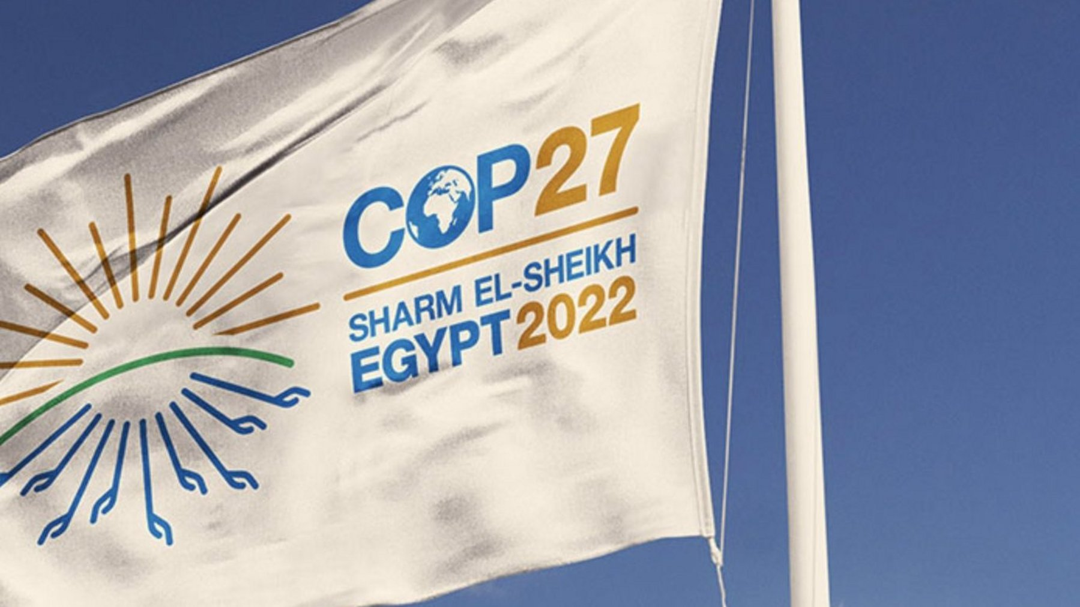


A Wider Gap in Promised “Implementation COP”
The “Implementation COP," which was promised by the Egyptian presidency, would witness a transition from previous commitments to balanced action on combating climate change and preparing for its impacts. The outcomes were really mixed, focusing more on the effects of climate change than its causes. However, a decision that did nothing to further attempts to remain below 1.5C, beyond what had been agreed at COP26 in Glasgow last year, drew significant criticism from the EU and its allies. All of this occurred against a backdrop of converging worldwide food, oil, and debt problems, as well as allegations of human rights violations against the Egyptian government.
Climate Justice Gap
Recognizing that climate change is a widespread concern for humanity, Parties should respect, promote, and consider their respective obligations regarding human rights, a healthy and sustainable environment, the right to health, the rights of indigenous peoples, local communities, children, and people in vulnerable situations when taking action to address climate change.
Political Agenda Gap
The U.N. climate agency released a revised draft of a suggested final agreement for the COP27, fleshing out certain crucial provisions of the agreement that nations are finding difficult to come to. The roughly 200 nations attending the climate meeting in Egypt would need to approve the document, which serves as the overall political agreement for COP27.
Inevitably, attention shifted away from climate justice and toward hard science and finance. Even the conclusion report only made a cursory acknowledgement of the full scope of the disproportionate effects of the climate problem on civilizations.
A day after the meeting was supposed to end, several other agreements are still being fiercely negotiated alongside the so-called "cover decision." Only a small portion of the document addressed the sensitive topic of "loss and damage" compensation to nations affected by climate-related calamities.
It left a blank space where text might be written later, if necessary, in the part for financial arrangements for loss and damage. Researchers and activists attending the talks for the first time described disbelief as government negotiators spent days going back and forth over single words in the document.
As a result, it was unable to offer practical methods for dealing with this. More than just acknowledgment is required for truly just grassroots action.
India's contribution to historical cumulative CO₂ emissions is 3%, whereas the US and EU contributed 25% and 17% respectively to total fossil CO₂ emissions from 1850 to 2019. China contributed 13%, the Russian Federation 7%, and Indonesia and Brazil 1%.
Despite the Indian proposal that all fossil fuels should be phased out, the COP27 accord failed to go beyond the Glasgow climate pact's vow to "phase down unabated coal power."
In addition, no new goals or promises were made in the document, endangering the Paris Agreement's ambition of keeping global temperature increases to 1.5°C. The negotiations at COP27 were significantly impacted by these issues. In the final version, language advocating the phase-out of fossil fuels was removed, and new language encouraging the rapid development of "low-emission" energy systems was added. Many are concerned that this language will be used to support greater natural gas production. The success of loss-and-damage discussions could be hampered by the failure to restrain fossil fuel interests.

Slide 35

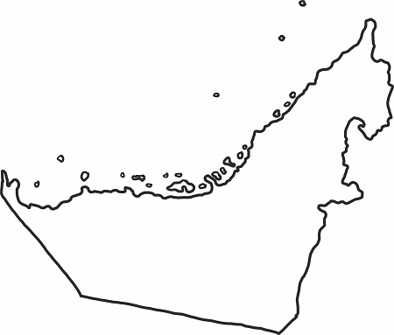
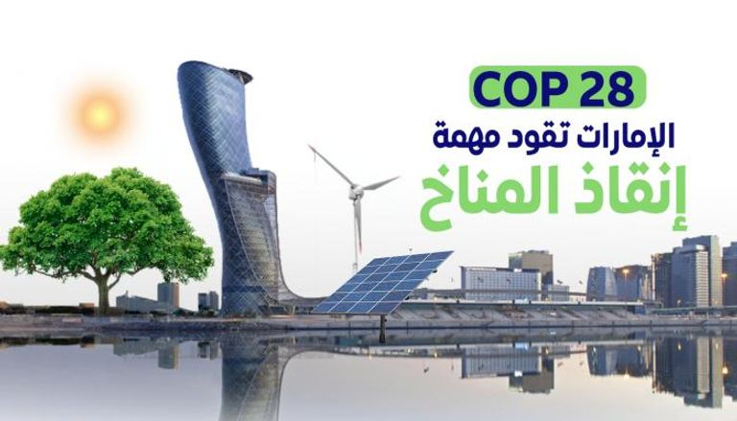
Way Ahead towards COP28
It is anticipated that the COP27 and COP28 discussions would result in a move toward implementation and solutions. They must also commit to broad support and be inclusive of all needs and geographical areas if they are to succeed. If we want to build an equal and robust future for everyone, sharing solutions with emerging nations is crucial. The accomplishment of these goals is of great interest. One of the first in the Middle East, the government of the United Arab Emirates has launched the Net Zero by 2050 Strategic Initiative, which pledges to achieve carbon neutrality globally by the year 2050 and acknowledges the role emerging and developing economies play in the solution. Over 70 nations on six continents have received US$17 billion in investments from the UAE for renewable energy initiatives.
Best Way Ahead for COP28 Implementation
COP28 and Dubai can learn several things from this. First, begin the negotiations right away and work diligently over the following 12 months to ensure that all nations are ready to reach a definitive agreement by the end.
For all nations to understand what is being negotiated and for confidence to be rebuilt, the next COP must conduct an open and transparent process. So that there is a chance of staying below the 1.5 C limit with a focus on phasing out fossil fuels, countries in Dubai must be pressed to increase their commitments.
Future Negotiations Foundation
Wealthy rising economies and high-income nations must contribute to adaptation funds and a functional and open loss and damage facility. The goal of COP27, an African COP, was to make climate justice the focal point of the talks.
As money will need to be put on the table for adaptation, loss and damages, as well as a swift ramp-up of renewables, this concept will need to be at the center of the COP28 negotiations.
The Middle East is a place of striking differences. It is home to both privileged and impoverished people, industrialized and emerging nations, and both abundant and scarce energy sources. Lack of freshwater, constant construction, and reliance on air conditioning all contribute to high carbon footprints. Even if some nations are awash in oil, they nonetheless face daily energy challenges. At COP27 in Egypt and COP28 in the United Arab Emirates, it is hoped that the transition to clean renewable energy and robust water infrastructure would finally make forward. However, the issues are complicated, which makes implementation difficult.

Slide 36

Contact Us
Name with Designation
Mobile and Email ID
Name with Designation
Mobile and Email ID
Name with Designation
Mobile and Email ID
Name with Designation
Mobile and Email ID
Name with Designation
Mobile and Email ID

